Slide 1

MACHINE LEARNING PROJECT ON MOVIE RECOMMENDATION SYSTEM
Presented By : Suryansh Chaturvedi
Univ. Roll No – 171500349
Department of Computer Engineering & Applications
Institute of Engineering & Technology
GLA University, Mathura

Slide 2
OBJECTIVE
Recommend the movies to the user using Collaborative filtering.
Understand the use of Surprise package in python.

Slide 3
Content
Introduction to Machine Learning
Supervised and Unsupervised learning
Introduction to Recommender System
Movie Recommender System
Tools and technique used
Dataset
Implementation and UI
Conclusion

Slide 4
Machine Learning
The ability of computer to learn automatically.
Improve from experience without being explicitly programmed.
Give computer power to predict something.
It is of 2 types:-
Supervised Learning
Unsupervised Learning

Slide 5
Supervised Learning
Input and output variables will be given.
When new input set given predict the output.
It includes:-
Classification
Regression

Slide 6
Unsupervised Learning
Only input data will be given.
Model the hidden patterns in the given input data in order to learn about the data.
It includes:-
Clustering
Association

Slide 7
Recommender System
Produce a ranked list of items in which user interested in.
Use filtering systems to predict the rating.
Helps in deciding what to wear , what to buy etc.
Applied in variety of applications like movies , books etc.
It is of 2 Types:-
Content-based filtering
Collaborative filtering

Slide 8
Movie Recommender System
Content-Based:-The recommendation system recommends the movies that are similar to the selected movie.
Ex:-f(movie)→{movies}
Collaborative:-The recommendation system recommends the movies that are highly rated by the similar users.
Ex:-f(movie , user)→{movies}

Slide 9
Tools and techniques Used
Surprise package
SurPRISE roughly stands for Simple Python RecommendatIon System Engine.
It is a python scikit building and analyzing recommender systems.
Alleviate the pain of Dataset handling as it has builtin datasets.
Provide various builtin algorithms(SVD,KNN)
Provide various similarity measures(cosine,pearson)

Slide 10
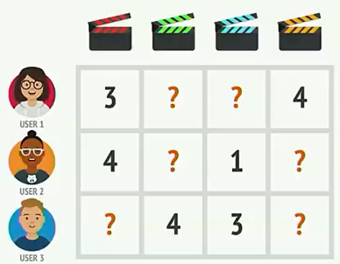
Tools and techniques Used
SVD(Single Value Decomposition)
Collaborative filtering algorithm
Uses Matrix factorization technique.
User-movie rating matrix

Slide 11
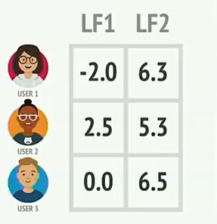
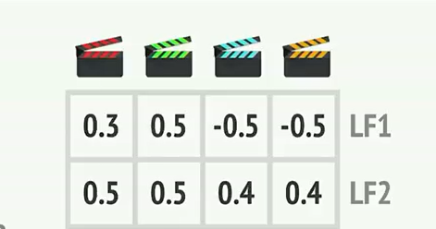
Tools and techniques Used
Matrix Factorization
Decomposing the user-movie interaction matrix into the product of two lower dimensionality rectangular matrices.
Latent features are used to calculate estimate rating.
Two matrices User and Movies with two latent features

Slide 12
Tools and techniques Used
Dataset module
Present in surprise package.
Use reader class to read dataset from file.
Use to build trainset.
Reader class
Present in surprise package.
It’s object passed in dataset module function to read.

Slide 13
Tools and techniques Used
Tkinter
Used for developing GUI.
Steps to create a tkinter:
Importing the module – tkinter
Create the main window (container)
Add any number of widgets to the main window
Apply the event Trigger on the widgets.

Slide 14
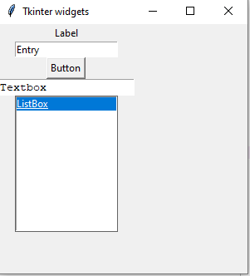
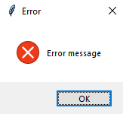
Tools and techniques Used
Tkinter Widgets
Label
Entry
Button
Text
Listbox
Tkinter messagebox
Used to show error,info or warning.

Slide 15
Dataset
We are using movielens dataset in this project which contains:-
ratings.csv:-
Contains ratings of 610 users for different movies they rated.
It’s structure is userid,movieid,ratings(0.5-5),timestamp.
Use ratings data for collaborative filtering.
movies.csv:-
Contains the info of 9742 movies.
Contains movieId,title,genres of the movie.
Can be used to get moviename from movieid or movieid from moviename.

Slide 16
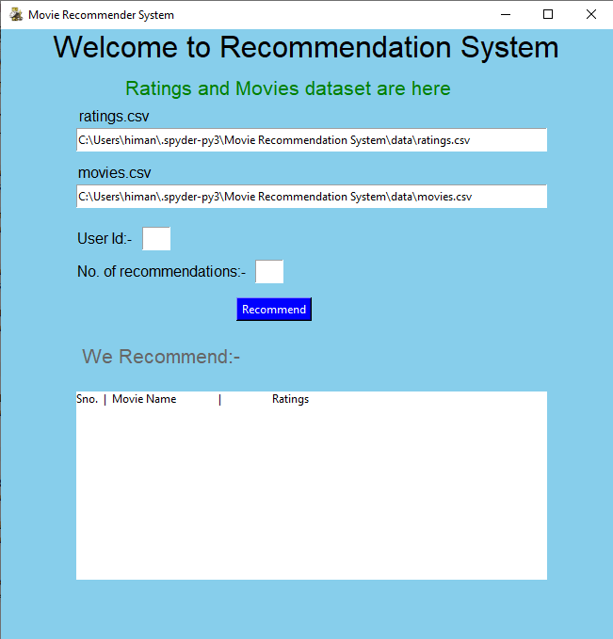
Implementation and UI
When we run our project,this screen appears.
First two entry’s in this labeled ratings.csv and movies.csv depicts where the data is stored in system.
We have two empty fields UserId and No. of Recommendations which are filled by user.
Then,there is Recommend button when we click it the recommendations are shown below the label We Recommend in the Listbox.

Slide 17
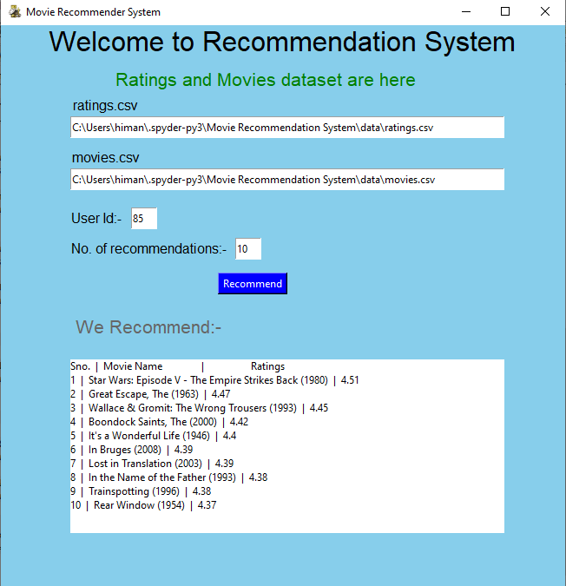
Implementation and UI
In this,user filled UserId=85 and No.of recommendations=10
When we click on Recommend button,then 10 recommendations are shown below to the user with their estimated ratings.

Slide 18
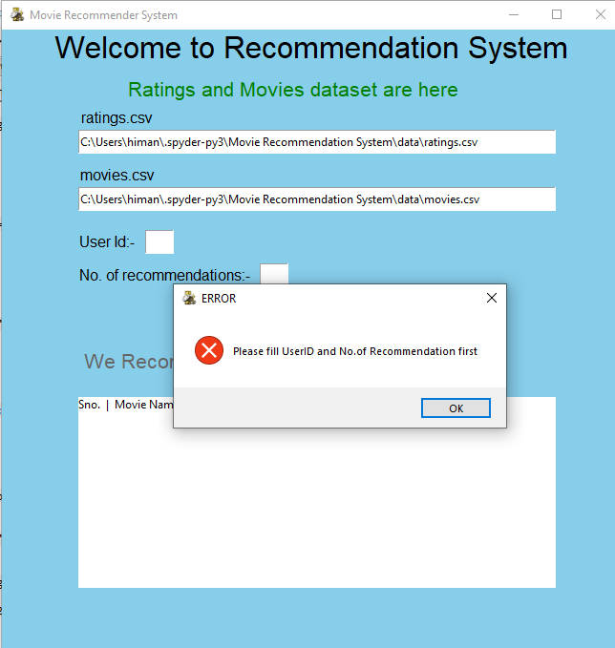
Implementation and UI
If we click,on the Recommend button,without entering the UserId or No. of recommendations field,then this message box appears.
This shows an “Error” and also tells you to Fill above fields.

Slide 19
CONCLUSION
"Movie Recommender systems are a powerful new technology for extracting additional value for movie websites like Netflix and Youtube from its user databases.
These systems help users find movies they want to watch from a website.
Movie Recommender systems benefit users by enabling them to find movies they like.
Conversely, they help the websites by generating more users.
Movie Recommender systems are rapidly becoming a crucial tool on the Web.

Slide 20
CONCLUSION
Movie Recommender systems are being stressed by the huge volume of user ratings data.
Our approach can be further extended to other domains to recommend songs, video, venue, news, books, tourism and e-commerce sites, etc.
These systems help users find items they want to buy from a business.

Slide 21
FUTURE SCOPE
In future, we can improve the effectiveness and performance by exploring a hybrid system.
Hybrid System uses Content and Collaborative filtering.
Input
CF Based
Recommender
Combiner
Recommendations
Input
Content Based
Recommender
A Hybrid System

Slide 22
BIBLIOGRAPHY
Tkinter geeksforgeeks.org
Surprise package surprise.readthedocs.io
CF and Content based filtering towardsdatascience.com
Python functions javatpoint.com
Tkinter messagebox pythonspot.com

Slide 23
THANK YOU

